Slide 1
SSIP HACKATHON
Presentation
Technical Overview

Slide 2
Functions of our Blockchain based Land Registration system?
User Registration
Land Registration
Land Send
Transparent Blockchain data

Slide 3
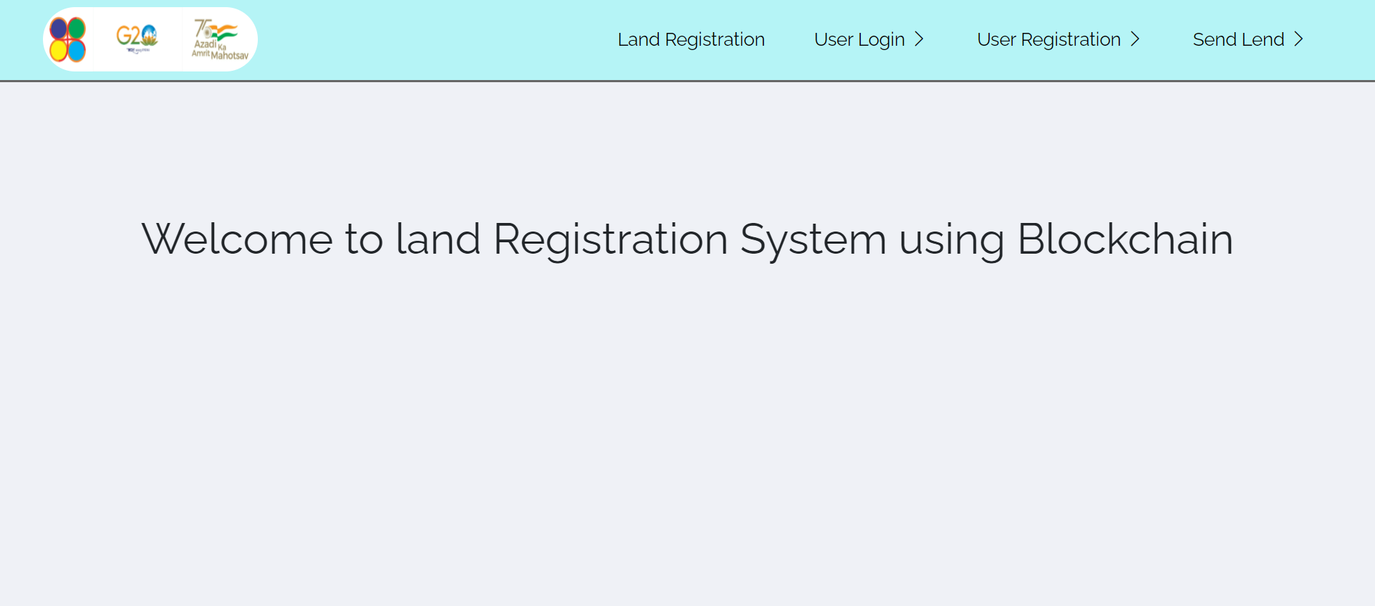
Home Page

Slide 4
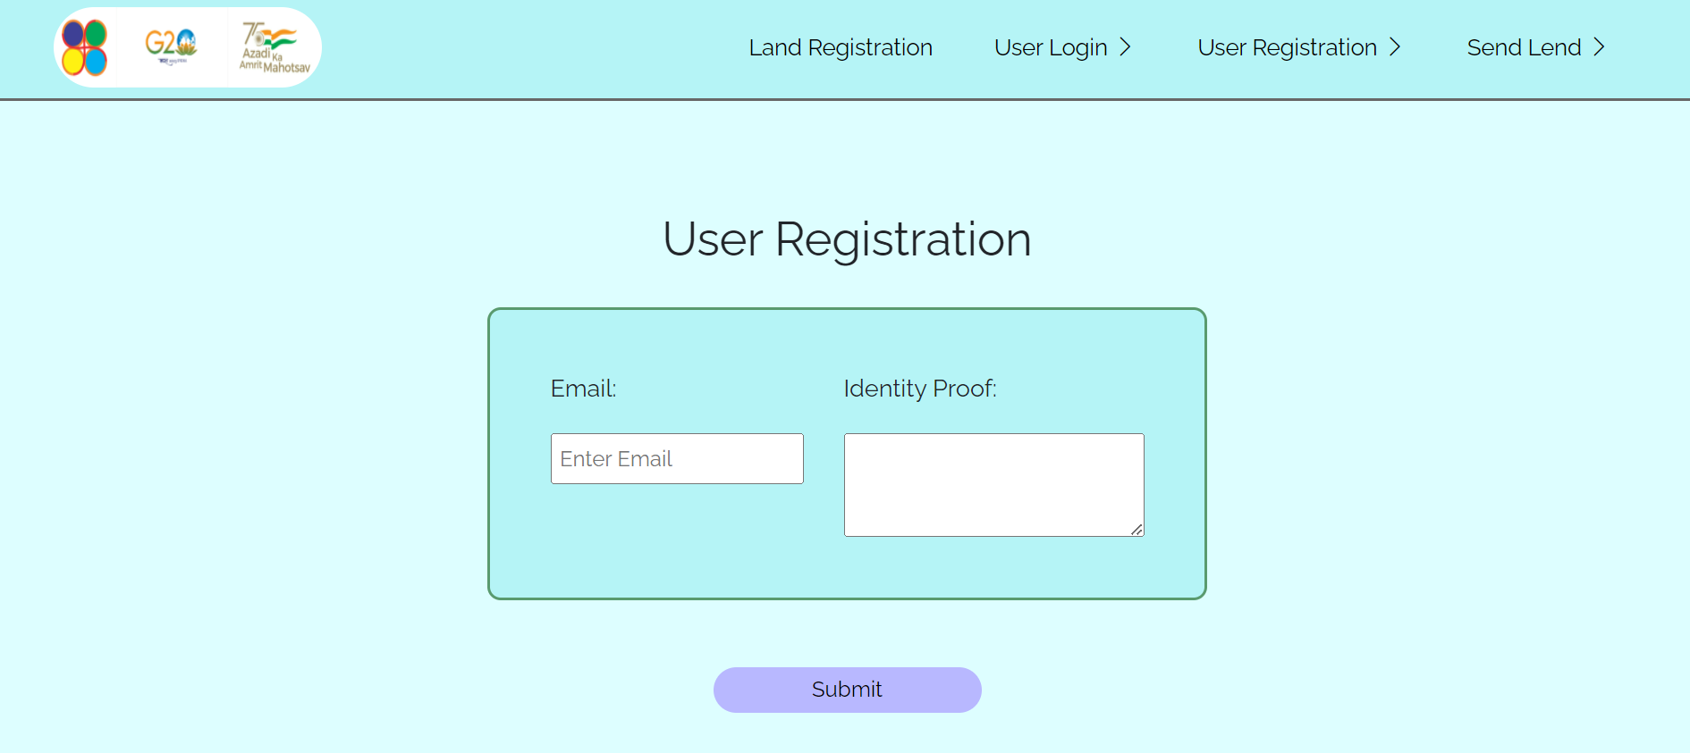
User Registration

Slide 5
User Registration
For Contact purpose to provide Public and Private key to the user through email after Successful validation of the Identity document Provided by user.
Currently We assume that all documents provided by user is True as we are presenting our idea.
A user registration do the following things and save in the database.
Generating Public key
Generating Private key

Slide 6
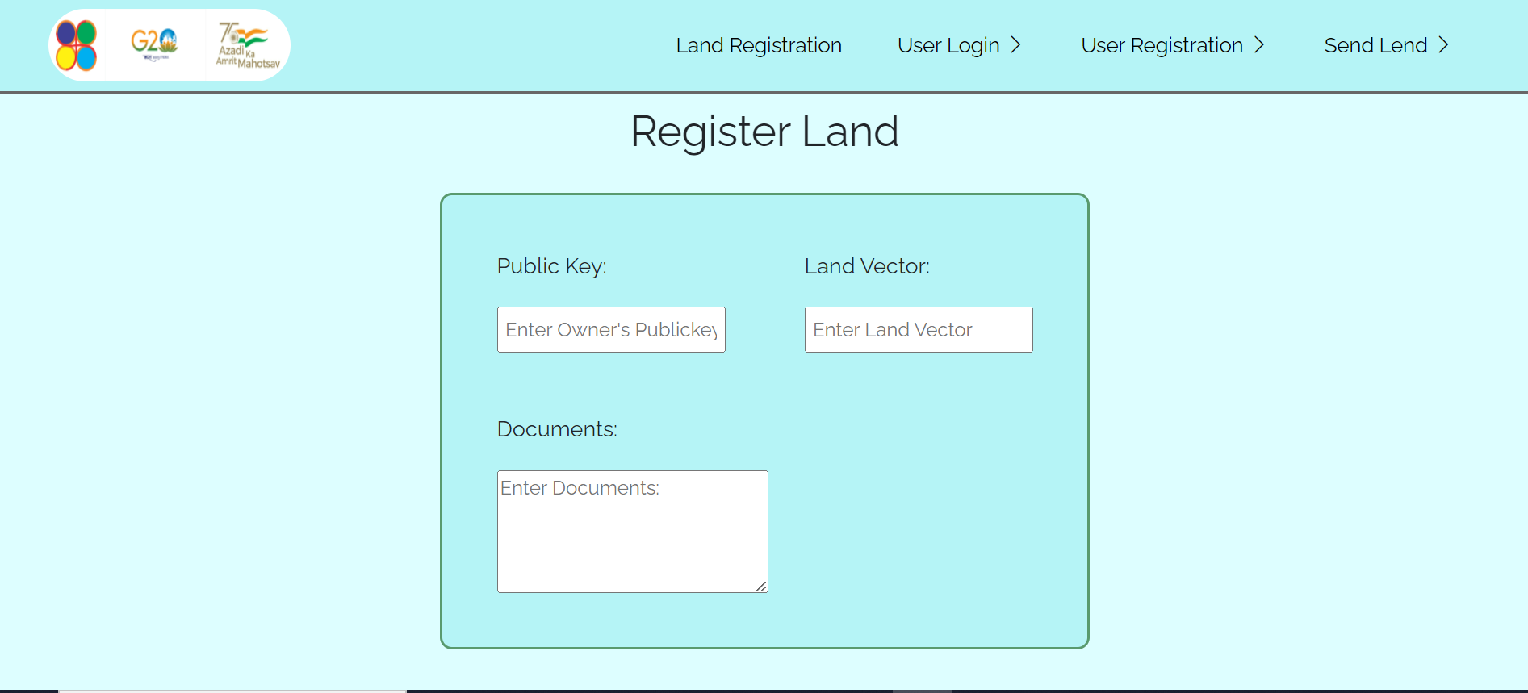
Land Registration

Slide 7
Land Registration
It is available for registered users
We are mapping the land by using Longitude and Latitude vector
First of all user will enter his public key for getting ownership of that particular land in Blockchain
After that he will provide particular documents for transferring the land from Current Land System to Blockchain.
When he submit all those thing few things happen in the backend

Slide 8
System will first find that the user want to register exists in the database or not
Then System will generate particular land ID for his land and then it will be allocated to him.
Now this allocation of land happens in transaction as that the receiver’s Public key, Null in the sender’s key as he is registering the land into Blockchain.
Now system will check that those land vectors are not already registered.
And at the End System will push the Block with the hash of the previous block in the Blockchain, and flagging itself as the latest block in the Blockchain.

Slide 9
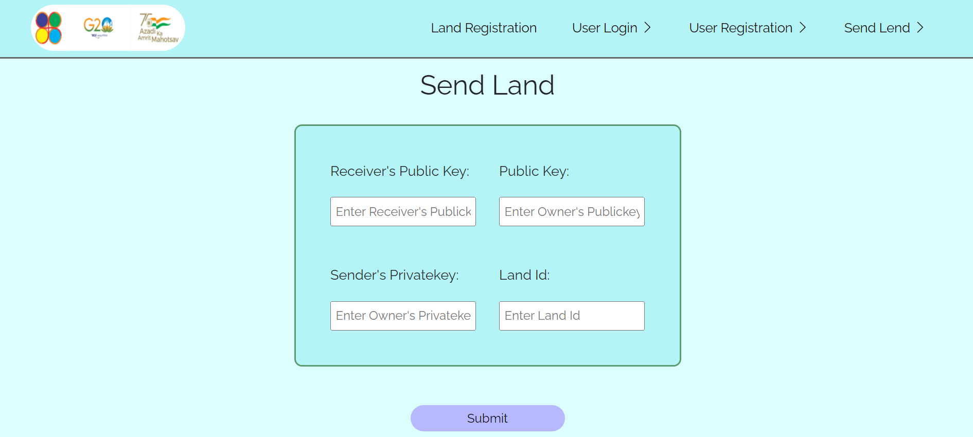
Land Transfer

Slide 10
Land Transfer
Again it is available to registered users only also land can be sent to the user who is also registered.
It requires Publickey of sender, Privatekey of sender, Receiver’s Public key and also Land Id.
Although it do not require any document for sending, But for add an extra layer of security for beginning phase we can ask for document.
Now the transfer of land includes multiple concurrent processes in the backend which is listed and defined in the next one.

Slide 11
It includes first validation of that the provided land Id exist or not, If does not exist then stops processing and redirect to the register land Page
Then it checks for the owner of the particular land and cross verify through here.
After that if the public key matches with the owner of the land the it will finally check for Private key for validation of the user
If the private key do not match then it will stop the all processes and redirect user to the same page again.
If everything is okay then it will generate block with random hash followed by previous block’s hash

Slide 12
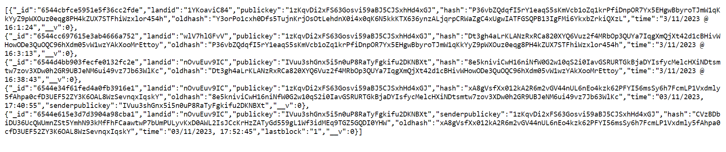
Transparent Blockchain data

Slide 13
Transparent Blockchain data
It is the API endpoint where all the data of the Blocks and details inside them are made public and transparent
By using this government can add more peers to the network easily by sharing the same ledger.
We can use this data to validate which land are owned by the particular user
We can also use this to verify the current owner of the land.

Slide 14
HOW THIS SYSTEM CAN HELP GOVERNMENT TO SOLVE THEIR PROBLEM
Moving Towards digitalization as per digitalization of India Scheme.
Difficulty to track double selling of the same land or landed property, We can see that who is the real owner of the land which can be only 1.
Financial Institutions need to verify the proper documents and that’s why there is a lot of paperwork to taking a loan against the land

Slide 15
The transactions related to change of ownership through sale, loan, mortgage, release of mortgage, crop updation is initiated by other departments
As per requirement of any department with the help of Blockchain and Smart Contracts (Script to be executed in the Blockchain) we can do bulk process in the Blockchain to get the data from it
In government schemes like Farmer Aid program, People takes multiple advantage of single land to obtain Multiple Aids , which can be solved using the Blockchain

Slide 16
The transactions related to change of ownership through sale, loan, mortgage, release of mortgage, crop updation is initiated by other departments
As per requirement of any department with the help of Blockchain and Smart Contracts (Script to be executed in the Blockchain) we can do bulk process in the Blockchain to get the data from it
In government schemes like Farmer Aid program, People takes multiple advantage of single land to obtain Multiple Aids , which can be solved using the Blockchain

Slide 17
Thank you !

